Slide 1

Auto-Grader: An Automated Answer Sheet Checker
Project Instructor - Prof. Anil Kumar Singh
Department of CSE
MNNIT Allahabad

Slide 2
Team Members (Group No. - 21)
Nishchay Chaurasia (20204129)
Niraj Kumar Gupta (20204128)
Nilesh Malav (20204127)
Nitesh Rana (20204130)

Slide 3
Contents
Introduction
Motivation
Architecture and Design
Challenges and Best Practices
Result and Analysis
Future Direction
Conclusion
References

Slide 4
Introduction
Auto-Grader introduces advanced technology to revolutionize and modernize assessment methods.
Focuses on content, coherence, and relevance for comprehensive evaluations.
NLP ensures precise scoring, utilizing advanced algorithms to evaluate responses thoroughly.
Auto-Grader automates the assessment process, significantly reducing the time and effort required for manual grading.
By minimizing human biases and inconsistencies, it contributes to a fair and objective grading process.

Slide 5
Motivation
Efficiency and Time-saving:
Grading numerous answer sheets manually is time-consuming for educators.
Auto-Grader automates the evaluation process, significantly reducing grading time.
Allows educators to focus more on personalized teaching and student engagement.
Consistency and Objectivity:
Human grading is susceptible to inconsistencies and subjectivity.
Auto-Grader ensures standardized evaluation criteria.
Provides objective scores based on established algorithms, eliminating biases and ensuring fairness in assessment.
Scalability and Accessibility
Managing assessments for a growing number of students poses challenges.
Auto-Grader offers a scalable solution, accommodating a large volume of assessments.
Can handle various subjects and levels of complexity, making quality education accessible to more learners.

Slide 6
Motivation
Enhanced Learning Experience
Instant feedback is crucial for student learning.
Auto-Grader provides quick and detailed feedback.
Enables students to understand mistakes and areas needing improvement promptly.
Integration of Technology in Education
Auto-Grader leverages Natural Language Processing (NLP) to merge technology with education.
Showcases the potential of innovative solutions in enhancing traditional teaching and assessment methods.
Motivation for the Project
Belief in the transformative potential of innovative educational technologies.
Aspiration to transform traditional educational practices, improve accessibility, foster collaboration, and enhance the overall quality of education globally.

Slide 7
Architecture and Design
Transforming Answers to Text: Image capture and OCR conversion. Utilizing OCR technology to convert handwritten or printed text into machine-encoded format.
Processing Answers with NLP:Sentiment analysis, similarity measurement, and entity recognition. Leveraging NLP for understanding and evaluating textual content.
Generating Scores: Collection and normalization for analysis. Preparing data for accurate assessments through standardization and cleaning.
Similarity-based scoring and expert validation. Evaluating correctness through similarity
measures and expert input.

Slide 8
Architecture and Design
Flask and Ngrok: Flask is a web framework used to develop server-side web applications in Python and Ngrok is tool to expose local servers securely for temporary public access.
NLP: Natural Language Processing, a field in AI focusing on interaction between computers and human language, enabling tasks like language understanding, translation, and sentiment analysis.
Generative Model: AI model creating new data resembling existing datasets by learning patterns to generate similar but distinct examples.

Slide 9
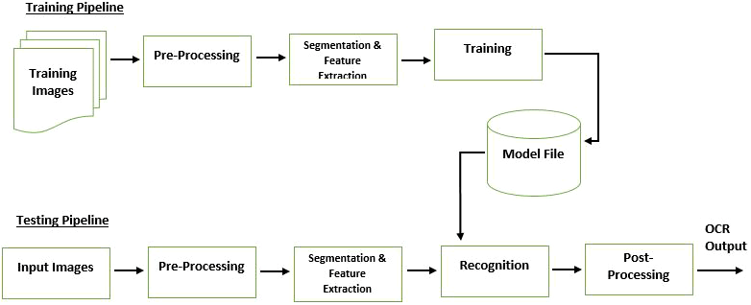
OCR Design

Slide 10

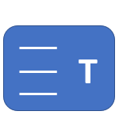


Workflow
Prompt
Score

Slide 11
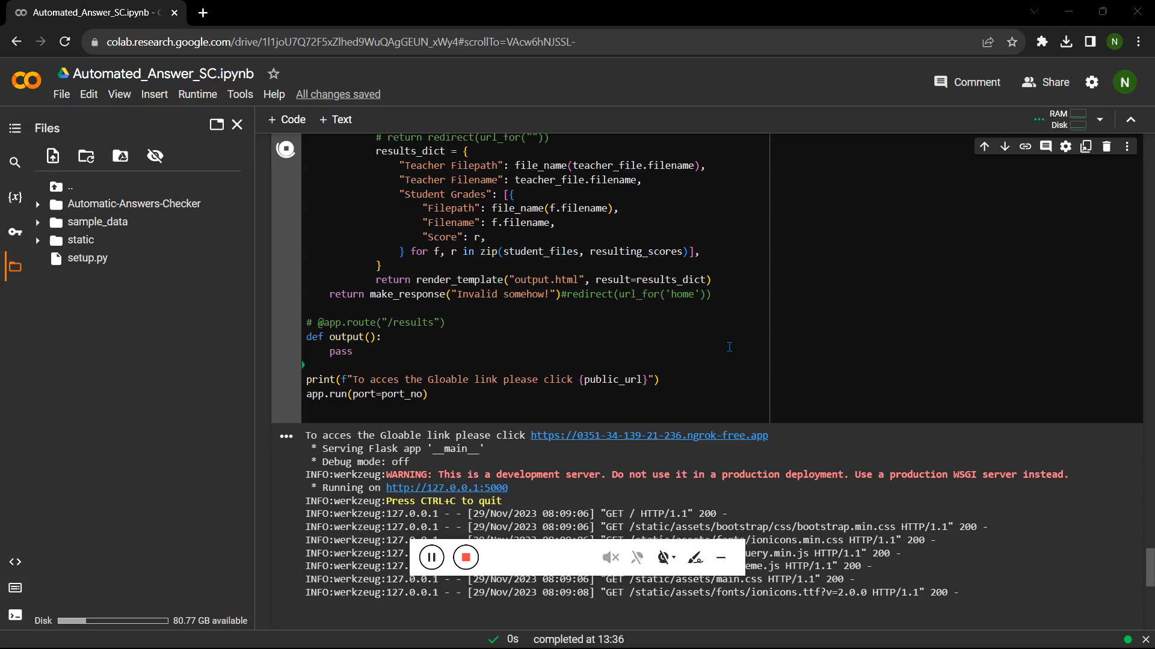
Demo Video

Slide 12
Challenges
Subjective Questions: Grading subjective answers accurately based on varied interpretations presents a challenge due to the subjective nature of language.
Scalability: Ensuring the system can handle grading for a large number of students and diverse question types without compromising accuracy or speed.
Adaptability to Diverse Subjects: Creating models that effectively grade answers across different subjects or domains, each with unique content and assessment criteria.
Handling Ambiguity: Addressing ambiguous or vague answers where multiple interpretations might exist.

Slide 13
Best practices:
Robust Data Collection: Gather diverse, high-quality datasets covering various question types and correct/incorrect answers to train the grading model effectively.
Feedback Mechanism: Incorporate a feedback loop where human experts review discrepancies, providing corrective input to refine the model continuously.
Transparency and Interpretability: Ensure the grading process is transparent by providing explanations or reasoning behind grades, aiding both students and educators in understanding assessments.
Scalability and Performance: Design the system to handle large volumes of assessments efficiently, ensuring speed and accuracy even with increased workload.

Slide 14
Results and Analysis
Analyzing the results of an auto-grading system involves a comprehensive examination of its performance across various dimensions.
This assessment typically encompasses evaluating the system’s accuracy in grading, measuring its consistency against human graders, and understanding the effectiveness of the feedback provided to students.

Slide 15
Results and Analysis
GPT:
GPT stands for "Generative Pre-trained Transformer," an advanced AI model by OpenAI that understands and generates human-like language across different tasks without needing specific fine-tuning for each task.
Bert:
BERT stands for "Bidirectional Encoder Representations from Transformers," a Google-developed language model proficient in understanding context from both directions, excelling in multiple NLP tasks without needing task-specific fine-tuning, thanks to pre-training on extensive text data.

Slide 16
Results and Analysis
LLama
LLaMA (Large Language Model Meta AI) is a family of large language models (LLMs) released by Meta AI in February 2023. LLaMA is trained on various model sizes, ranging from 7 billion to 65 billion parameters.
Code Llama is an AI model built on top of Llama 2, fine-tuned for generating and discussing code. It's free for research and commercial use.
LaMDA:
LaMDA is built on Transformer, Google's open source neural network architecture for natural language understanding. Models built on this platform are trained on datasets to find sentence patterns, create word correlations, and predict the next word.

Slide 17
Results and Analysis

Slide 18
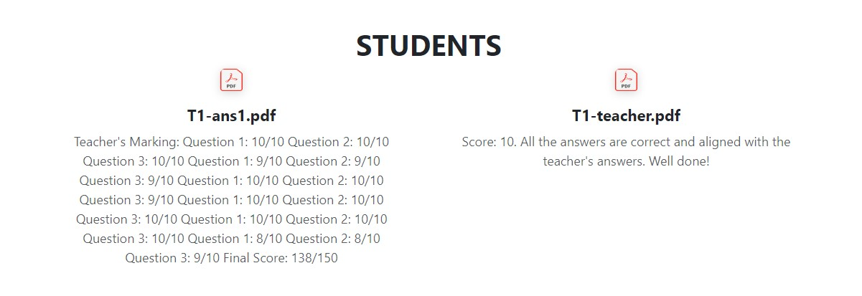
Results and Analysis
Total scoring of student 1 answer sheet

Slide 19
Results and Analysis
Model Type | Teacher | Student1 | Student2
Run1 | 10 | 9 | 4
Run2 | 10 | 8 | 5
Run3 | 10 | 9 | 5
Run4 | 10 | 8 | 4
Analyzing Variations: Multiple Runs of NLP Models

Slide 20
Results and Analysis
Feature | GPT-3 | BERT |  |  | LaMDA
Model Type | Autoregressive | Bidirectional |  |  | Decoder-Only
Training Data | Diverse web text and code | Wikipedia, BooksCorpus |  |  | Dialogue data
Training Objective | Next word prediction | Masked language modeling |  |  | Dialogue loss
Fine-tuning Approach | Few-shot learning | Task-specific fine-tuning |  |  | Prompt-based fine-tuning
Strengths | Strong generative capabilities, versatile, multitask learning | State-of-the-art in many benchmarks, effective for domain-specific tasks |  |  | Strong factual language understanding, robust to adversarial attacks, generates different creative text formats
Weaknesses | High computational and memory requirements, limited fine-tuning capabilities | Slightly limited compared to XL models in handling long contexts, moderate interpretability |  |  | Requires more computational resources than BERT, less interpretable than BERT
Common Applications | Language generation, text summarization, question answering | Sentiment analysis, text classification, natural language inference |  |  | Dialogue generation, chatbot development, question answering
Comparison of different models

Slide 21
Future Direction
Enhanced Adaptability: Advancing models to be adaptable across various subjects, languages, and educational levels, ensuring broader applicability.
Feedback Personalization: Developing systems that provide personalized feedback tailored to individual student needs, fostering better learning outcomes.
Advanced Assessment Types: Expanding capabilities to assess more complex responses, including essays, creative writing, and critical thinking exercises.
Real-Time Feedback: Implementing systems capable of providing instant feedback to students, aiding immediate comprehension and learning adjustments.
AI-Human Collaboration: Fostering collaboration between AI systems and human educators for more effective and comprehensive assessments.

Slide 22
Conclusion
Auto-grading systems driven by AI and NLP offer scalability, efficiency, and objectivity in educational assessments.
Challenges such as subjective assessments and maintaining fairness require ongoing refinement and robust data curation.
Continuous improvement, adherence to best practices, and collaboration between AI and education experts are crucial for advancing these systems.
The future entails refining these systems for adaptability across subjects, empowering educators with valuable tools for effective teaching and learning assessments.
Through innovation and ongoing refinement, auto-grading systems have the potential to revolutionize education by promoting fairness, objectivity, and insightful assessments.

Slide 23
References
Ray Smith, Google Inc., “An Overview of the Tesseract OCR Engine”
T. Gunawardena, M. Lokuhetti, N. Pathirana, R. Ragel and S. Deegalla, “An automatic answering system with template matching for natural language questions,” 2010 Fifth International Conference on Information and Automation for Sustainability, Colombo, 2010, pp. 353-358
M. Jangid and S. Srivastava, “Automatic Objective Answer-Sheet Evaluation-A OCR Based Approach1,” 2013 IEEE International Conference in MOOC, Innovation and Technology in Education (MITE), Jaipur, 2013, pp. 224-227

Slide 24
Thank You !

